Slide 1

Don Berman
Co-Founder, Chief Evangelist
Today’s Speaker
Throughout his career, Don Berman has been a driving force in the world of HR and talent management technology, collaborating with both domestic and international companies to empower them with innovative solutions. As the co-founder and business development lead of JDXpert, Don was instrumental in the company's pivot towards a job description-centric model, which has helped establish JDXpert as a market leader in job description management solutions. Currently leading the company's sales, thought leadership and partnership initiatives, Don's unparalleled expertise and guidance are instrumental in shaping JDXpert's direction and driving its continued growth.

Slide 2
What the Tech!
HR, Talent, and Comp Tech Trends Bound to Make Waves
Notes:
HI all,
Our goals:
Share some interesting perspectives
Find out what you think
And expose you to what your peers are doing/thinking
We’re gong to do this via a series of Poll Questions about specific Scenarios you may be confronted by.

Slide 3
Poll
Are you currently using AI to write job descriptions?
Yes
No
Notes:
But first let’s find out a little about you.

Slide 4
Poll
Are you currently using AI in your HR or talent management process?
Yes
No
Notes:
This would include Tools that you use that say they have AI embedded in them.

Slide 5
Purpose
To provide alternative views on major tech trends in HR, talent management and compensation
Allow you to weigh in and see where your peers stand on these issues
Agenda
Trends covered
Generative AI
Skills/Skills-based recruiting
Pay transparency
Tapping into the hidden workforce
Critical HR tech platforms

Slide 6

Understanding AI and its Impact on Talent Management
All we hear about is AI
Why it Matters to Talent/HR: Critical in shaping the future of work: what/if tasks people will be doing, how talent will be compensated, managed and the overall talent landscape.
Generative AI Impact: Rapid advancements with tools like ChatGPT and Google Gemini, transforming work in many aspects of everyday business operations.
Notes:
-
-
- AI's journey from a theoretical concept to a key player in business strategies is remarkable
This session aims to unpack as much as we can about this topic and our other agenda items.
AFTER: Our first 2 Questions are about AI

Slide 7
Question 1
How will AI and automation impact traditional job roles, the labor market and the economy?
Notes:
BEFORE: Our first two Questions involve a nuanced interpretation on your part.
So we’ll describe 2 viewpoints and you determine which one resonates best with you.

Slide 8
Viewpoint Showdown
Viewpoint 1: AI and automation will lead to widespread job displacement, with many traditional roles becoming obsolete. This will cause significant disruption to the labor market, leading to high unemployment and economic instability.
Viewpoint 2: While some jobs will be impacted by AI and automation, new roles and industries will emerge to replace them. This technological transformation will create more efficient and productive work, ultimately leading to economic growth and new opportunities for workers.
Notes:
Some believe that many job functions, like the ones that are easily repeatable and can be automated, will be displaced widely.
Outside of the obvious jobs like data entry, GenAI introduces significant risk to jobs that require some level of training that has traditionally only been accomplished by the human brain but now can be accomplished with complex machine learning. Even Jobs like truck drivers, radiologists, graphic designers, accountants, and customer service reps are all at risk for massive disruption. We might see high unemployment and economic instability as the world evolves and embraces AI.

Slide 9
Job Displacement by the Numbers
Workers Displaced
Jobs Lost
Employees Over 7 Years
Wage Reductions Caused by AI Automation Since 1980
AI Replacing Jobs Statistics: The Impact on Employment in 2024 (seo.ai)
Must-Know AI Replacing Jobs Statistics [Latest Data 2024] • Gitnux
Notes:
14% of workers have already experienced job displacement due to automation or AI.
In May 2023, 3,900 job losses in the US were directly attributed to AI, accounting for 5% of all job losses that month.
British Telecom plans to reduce its workforce by 10,000 employees over 7 years, partly through AI and automation.
Evidence suggests AI and automation have caused up to 70% wage reductions for some workers since 1980.

Slide 10
Job Displacement by the Numbers
Fear AI will replace them
American Jobs Overtaken by AI by 2030.
Jobs Across 32 Countries Highly Automatable
Jobs Likely to Change Significantly
AI Replacing Jobs Statistics: The Impact on Employment in 2024 (seo.ai)
Must-Know AI Replacing Jobs Statistics [Latest Data 2024] • Gitnux
Notes:
According to SEO.AI 30% of EEs are worried AI Will take their jobs.
Approximately 45 million American jobs might be overtaken by AI by 2030.
Certain occupations are more susceptible to automation, with around 14% of jobs across 32 countries highly automatable
and 32% likely to change significantly.
The impact will vary across industries, with manufacturing, retail, and transportation among the most affected.

Slide 11
Economic Impact
Income Inequality and Polarization
Advanced economies facing a 60% job exposure compared to 40% in emerging markets
Exacerbate income polarization
Polarization could deepen existing socioeconomic divides and contribute to social unrest
Economic Instability and Disruption
Widespread displacement of workers
Severe economic instability
China expected to absorb 42% of global AI-related job losses
Potential recessions or economic downturns
Notes:
Income Inequality and Polarization:
AI adoption is expected to widen the economic gap between developed and developing countries, with advanced economies facing a 60% job exposure compared to 40% in emerging markets.
Within countries, AI could exacerbate income polarization, with workers who can adapt to AI-driven roles seeing wage increases, while those unable to transition may face stagnant or declining incomes.
Polarization could deepen existing socioeconomic divides and contribute to social unrest.
Economic Instability and Disruption:
If not managed properly, the widespread displacement of workers leading to severe economic instability, with a significant portion of the population facing job losses and reduced purchasing power.
China, a major global economic powerhouse, is predicted to bear the brunt of job displacement, with 42% of global AI-related job losses expected to occur within its borders, potentially causing significant economic disruption.
The rapid pace of technological change and job displacement could outpace the ability of economies to adapt, leading to potential recessions or economic downturn

Slide 12
Viewpoint Showdown
Viewpoint 1: AI and automation will lead to widespread job displacement, with many traditional roles becoming obsolete. This will cause significant disruption to the labor market, leading to high unemployment and economic instability.
Viewpoint 2: While some jobs will be impacted by AI and automation, new roles and industries will emerge to replace them. This technological transformation will create more efficient and productive work, ultimately leading to economic growth and new opportunities for workers.

Slide 13
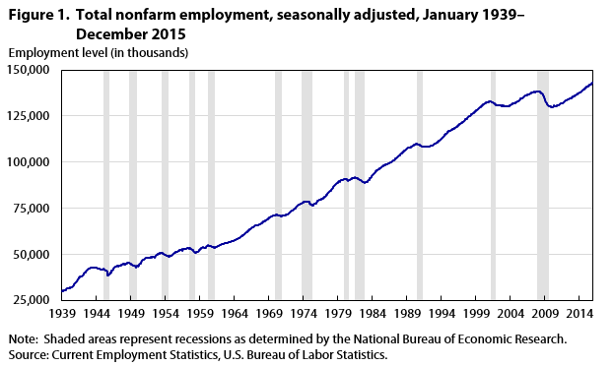
Evolution of Jobs
Driverless Cars
Personal Computers
AI
Spaceflight
Automation & Robots
Globalization
Computers
Transistors
Evolution of Technology: A Brief Timeline | LinkedIn
Notes:
Viewpoint 2 economic growth, productivity, economic and employment growth
Technology’s voice of Doom
1930s computers/Automation/Robots
1940s - Transistors – 1947 2
1970s Personal computers - - 1974 2
2010s - Driverless cars - Artificial intelligence (AI)
All of these technologies were slated to cost jobs, yet the upward trend of Jobs is unabated!
Now in2020s –GenAI
Post pandemic Job growth has been at near historic levels.
Labor Short is the bigger threat to employment

Slide 14
AI by the Numbers
300 million
250 million
200 million
150 million
100 million
50 million
10 million
Partially affected in the next 10 years
Displaced over the next 10 years
Created
Goldman Sachs
McKinsey
Chicago Booth Review
Notes:
300M Globally(Goldman)
Think Tasks not jobs -As AI improves the tasks it can do will change and Employees will pivot away from those tasks to others
Job Descriptions will be more important in the future.
Still 85M (World Economic Forum) could be displaced Globally By AI over the next 10 year
However, 97 M Jobs could be created

Slide 15
AI by the Numbers
Of us are now doing jobs that didn’t exist in 1940
Jobs in AI tech will be added by 2027
Tasks heading toward automation before GenAI
Tasks after GenAI
AI could represent a 7% ($7 Trillion) increase in GDP over 10 Years
Goldman Sachs
McKinsey
Chicago Booth Review
Notes:
Remember 60% of us are now doing jobs that didn’t exist in 1940
The World Economic Forum’s 2023 jobs report predicts by 2027: 2.6 million jobs in AI Tech will be added.
Automation has been ab ongoing trend –
21% of tasks heading toward automation before GenAI.
29% After AI.
More impact from Robotics Kiosks
AI could represent a 7% ($7 Trillion) increase in GDP over 10 Years

Slide 16
Poll
Which viewpoint resonates with you? How will AI and automation impact traditional job roles, the labor market and the economy?
A. Viewpoint 1: AI and automation will lead to widespread job displacement and economic distress, with many traditional roles becoming obsolete.
B. Viewpoint 2: While some jobs will be impacted by AI and automation, new roles and industries will emerge to replace them, stimulating economic growth.

Slide 17
Question 2
At what pace will organizations adopt GenAI and Automation in Talent Management and what challenges will they face?

Slide 18
Viewpoint Showdown
Viewpoint 1: Slow - A cautious and gradual approach to the integration of GenAI and automation in talent management processes will be required because of the need deal with roadblocks that require careful consideration and mitigation.
Viewpoint 2: Rapid – The transformative potential of GenAI and automation in talent management processes will be irresistible due to the opportunities for organizations to enhance their competitive edge and drive innovation.
Notes:
Again, with this question we’ll paint two scenarios and let you decide.

Slide 19

Ethical Roadblocks
Bias
Government regulation
Privacy
Displacement of Workers
Generative AI in Talent Acquisition: Strategic Move or a Leap of Faith? - Draup
How GenAI Will Shape The Future Of Talent Acquisition And Management (forbes.com)
(24) Understanding AI: Adoption Insights and Challenges for Enterprises | LinkedIn
Notes:
Ethical Roadblocks:
Bias - Establishing Transparent processes to address bias and fairness in hiring and managing talent
Government regulation – This is still evolving, and companies will have to respond to a shifting set of regulations or better yet stay ahead of the curve
Privacy -Organizations will need to stringently protect personal data.
Regulations around this are also evolving
Displacement of Workers will cause ethical dilemmas for some organizations

Slide 20
Skill Gaps as a Barrier to Adoption
HR Professionals will require upskilling
At least 60% of organizations will face challenges in doing so
As of now less that a one-third of organizations are reskilling more than 30% of their workforce
Continuous learning mindset
Adapting continuous learning mindset will take time
Difficult to know what skills to include in upskilling and reskilling programs
Leading to persistent skill gaps that hinder their ability to adapt
Notes:
Skill Gaps as a Barrier to Adoption:
HR Professionals will require upskilling
At least 60…
Continuous Learning Mindset.
Adapting continuous learning mindset will take time.
As AI progresses the skills needed will be constantly changing and it will be difficult to know what skills to include in upskilling and reskilling programs

Slide 21

Resistance to Change Blocker
By stakeholders
Employees may be overwhelmed by the constant change
Overcoming this resistance will be challenging
Negative impact on culture
High turnover rates
Notes:
Resistance to Change:
By stakeholders who are accustomed to traditional talent management practices.
Employees may be overwhelmed by the constant changes and feel a lack of control leading to increased resistance and anxiety,
Overcoming this resistance will be challenging
Negative impact on culture
The relentless pace of change can erode employee trust, engagement, and loyalty,
Undermining the organization's culture and making it challenging to foster a collaborative, innovative environment
High Turnover rates

Slide 22

Other Key Considerations
IT Infrastructure
Time
Notes:
Flexible IT Infrastructure/Technology Adoption – Even with a flexible infrastructure implementing new technology takes a lot of time and energy
Time
Will we have enough in the face of an onslaught of AI Technology?
We all know the time it takes to implement technology. It is not hard to imagine that many organizations will fail to keep up.

Slide 23
Viewpoint Showdown
Viewpoint 1: Slow - A cautious and gradual approach to the integration of GenAI and automation in talent management processes will be required because of the need deal with roadblocks that require careful consideration and mitigation.
Viewpoint 2: Rapid – The transformative potential of GenAI and automation in talent management processes will be irresistible due to the opportunities for organizations to enhance their competitive edge and drive innovation.

Slide 24
Yes, but...
Agree with all the challenges stated in Viewpoint 1, but
Promise of GenAI is irresistible
  Productivity
  Quality improvement
  Doing that which was difficult or impossible to do before
If Organizations don’t provide tools employees will do it themselves
Tech companies are investing in AI at a record pace to provide GenAI enabled tools
Companies that do not adopt Gen AI will fail to compete

Slide 25
Poll
At what pace will organizations adopt GenAI and Automation in Talent Management and what challenges will they face?
A. Viewpoint 1: Slow - cautious and gradual approach
B. Viewpoint 2: Rapid – the transformative potential will be irresistible due to the opportunities for organizations to enhance their competitive edge and drive innovation

Slide 26
Question 3
What is skills-based recruiting and is it working?
Notes:
Don first

Slide 27

Recruiting: Skills-Based Job Postings
Less weight on education and experience because doing so:
  Drastically expands the talent pool
      By including those without degrees
      By adding in those with experience gaps or frequent job changes
Education level does not guarantee skills
Many ways to learn needed skills
Skillful, The Wall Street Journal
Notes:
Less weight on education and experience because doing so:
Drastically expands the talent pool
By including those without degrees
By adding in those with experience gaps or frequent job changes
Education level does not guarantee skills
Understand there are many ways to learn needed skills (internship/Externships/learn on your own)

Slide 28
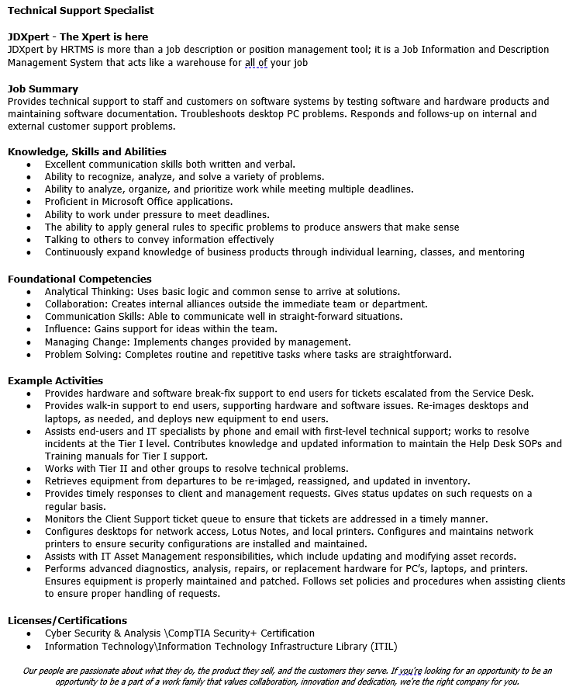
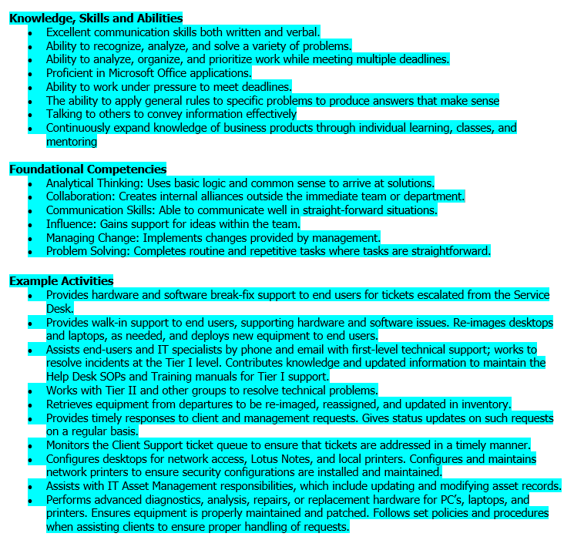
Skills-Based
Job Postings
Omit Education and Experience Requirements
Focus on
  Company Description
  Job Summary
  KSAs
  (Foundational) Competencies
  Example Activities (Essential Functions)
  Licenses and Certifications
  Physical Demands
  Disclaimers
Notes:
Skills based recruiting -- taking a different approach to the Job Posting
-
-
-KSAs AKA Hard Skills – focus on candidates who have the actual skills needed to perform in the job
-Foundational Competencies – Soft Skills – Intrinsic capabilities that are transferable between Jobs and industries.
-
-
-
-
The same rules apply to Job Posting and Web page– you need to capture attention up top and keep it putting compelling items up front.

Slide 29
Poll
Are you currently using skills-based recruiting methods
For most jobs
For some jobs
Not at all
Notes:
Before we get into the details, let’s see what you’re up to.

Slide 30






Skills-based Recruiting
What we’re hearing…
Benefits for Employers
Benefits for Employees
88%
Reduced mis-hires
69%
Employees feel that assessments reduce bias during hiring
  89%
Boosted retention rates
  80%
Employees agree that assessments help them better understand requirements
  82%
Reduced total time-to-hire
  74%
Reduced total hiring costs
  66%
Employees say they’ve gained access to new opportunities
  84%
Improved workplace diversity
47 key skills-based hiring statistics – TG (testgorilla.com)
Notes:
AFTER:
This data came from a survey of 3000 Employers/Employee and Employees by an assessment company. – Confirmation bias?
Consider audience of those being surveyed.

Slide 31

Skills-based Recruiting
What we’re hearing…
Creative Problem-Solving Trumps Impressive Portfolios
Diverse Skill Sets Drive Company Success
Practical Task Reveals True Capabilities
Skills Over Degrees Enhance Company Culture
8 success stories from adopting a skills-based ...Entry Level Jobs | Internships for Students | College Recruiter
Notes:
Explore the link to view the stories

Slide 32
Skills-based Recruiting
Disturbing Stats
3.5%
.14%
increase in hiring for those without a degree
hiring of candidates without degrees
Skills-based Hiring: The Long Road From Pronouncement to Practice( burningglass/HBS)
It’s No Surprise That ‘Skills-Based’ Hiring Has Not Worked (forbes.com)
Notes:
Burning Glass is Skills-Based Recruiting Advocate
According the Burningglass/Harvard Business School report on Skills based recruiting
Positions that were newly classified as not needing a degree saw a low 3.5% increase in hiring for those without one.
Net effect is a change of only 0.14 percentage points in incremental hiring of candidates without degrees,” the report found.
In other words, even without a degree requirement, college graduates got the jobs anyway.

Slide 33
Skills-based Recruiting
Other Factors
College grads also have skills
Has skills-based recruiting adoption been candid:
  45% name only
  20% backsliders
Hires without degrees are more likely to stay
Ingrained hiring processes are difficult to displace
Skills-based Hiring: The Long Road From Pronouncement to Practice (burningglass/HBS)
It’s No Surprise That ‘Skills-Based’ Hiring Has Not Worked (forbes.com)
Notes:
So What is behind this radical difference in statistics vs expectation in the Burningglass/HBS study
“skills-based hiring” – is deceptive. It presumes that people with college degrees don’t have skills –
“In name only” 45% companies were ones that announced a change but did not appear to make any changes to either their job postings or their hiring
Backsliders” 20% were firms that, after they announced policy changes, made “gains” in hiring applicants but reverted to pre-change levels, or worse
Even with lackluster stats, Hires without degrees are more likely to stay
-
the socializing and broad-based learning that goes on in college are valuable

Slide 34
Poll
Do you believe that skills-based recruiting is
A valuable tool in my company's recruiting strategy
Useful only for specific hard to fill jobs
Over-hyped and not useful
Not sure
Notes:
Ok, so without reading the Study/Article give us your gut feel on this one.

Slide 35

How Tech Can Help - Skills/ Skills-Based Recruiting
Skills taxonomy and market data
Job description management software
AI and machine learning
Skills assessment platforms
Virtual Reality (VR) recruitment
Notes:
Skills Taxonomy and Market Data.
Understanding which skill are important for which jobs and their value in the market.
Job Information Management
A granular understanding of Skills, Qualifications and Task is critical
AI and Machine Learning
AI and Machine Learning can improve recruitment results by automating arduous tasks, predicting outcomes, and analyzing data. These technologies can make it easier to find the right candidates for hard-to-fill positions.
Skills assessment platforms
Offer standardized skills assessments that can objectively measure a candidate's abilities
Virtual Reality (VR) recruitment
Offers an immersive experience that allows candidates to engage with an organization directly. VR can be used to give candidates an in-depth experience of what it would be like to work for or join an organization, which is particularly useful for remote and hybrid hiring.

Slide 36
Question 4
Can pay transparency ensure equity and meet evolving employee expectations around pay clarity?
Notes:
Don first

Slide 37




Labor Market Expectations
Flexibility
Transparency
Career Growth
DE&I
Lever
Notes:
The relationship between employer and Employee has changed due to the labor market.
What are applicants looking for.

Slide 38
Transparency: By The Numbers
80%
19
states currently have some sort of pay transparency law
wouldn’t apply for a job if salary range information was lacking
HRDive| Payscale
Notes:
According to a recent survey from ResumeLab, 80% of respondents said they likely wouldn’t apply for a job if salary range information was lacking,
And according to Payscale, 19 states currently have some sort of pay transparency law

Slide 39





Areas of Friction in Pay Transparency
62% would be demotivated -----
Employee Tensions and Jealousy
  60% would leave for a 10% raise -----
  8.4% gender gap in Uber backlash -----
  31% not ready & 46% delaying disclosure -----
  Difficulty Retaining and Attracting Talent
  16% have formal process -----
  Revealing Gender and Racial Pay Gaps
  Lack of Readiness and Resistance to Change
  Complexities in Implementation
https://www.ziprecruiter.com/blog/pay-trends-report/ https://www.business.com/articles/pay-transparency/ https://www.hiringlab.org/2023/03/14/us-pay-transparency-march-2023/
https://www.hiringlab.org/2023/09/14/pay-transparency-majority-of-us-job-postings/
Notes:
Potential for Employee Tensions and Jealousy
Openly sharing compensation details could lead to tensions, jealousy, and resentment among employees, especially if there are pay disparities.
According to a survey by Beqom, 62% of employees said they would feel demotivated if they discovered a colleague in a similar role was paid more.
Difficulty Retaining and Attracting Top Talent
Some companies fear that pay transparency could make it easier for competitors to poach their top performers by offering higher salaries.
A study by PayScale found that 60% of employees would leave their current job for a 10% raise.
Revealing Gender and Racial Pay Gaps
While pay transparency aims to address pay inequities, it can also expose existing gender and racial pay gaps within organizations.
For example, Uber faced backlash in 2019 after revealing that women at the company earned around 8.4% less than men in similar roles.
Lack of Readiness and Resistance to Change
According to a survey by Willis Towers Watson, 31% of employers stated they are not ready for pay transparency, and 46% are delaying disclosing pay information.
Complexities in Implementation
Implementing pay transparency effectively requires careful planning, clear communication strategies, and addressing employee concerns proactively.
A study by Payscale found that only 16% of organizations have a formal process for sharing pay data with employees.

Slide 40
Poll
What level of pay transparency do you currently practice in your organization?
No transparency (pay information is confidential)
Limited transparency (pay ranges shared internally)
Moderate transparency (pay ranges shared externally for job postings)
Full transparency (all employee compensation data is openly shared).
Notes:
Ok, so without reading the Study/Article give us your gut feel on this one.

Slide 41

How Tech Can Help – Pay Transparency
Technologies
Compensation Management Software
People Analytics and Dashboards
Job Information Management Software
Tactics
Pay range disclosures
Real-Time Access to Pay Data
Notes:
Compensation Management Software
Pay Equity tools to Analyze current pay data, identify disparities, and model different compensation scenarios.
People Analytics and Dashboards
Develop interactive dashboards and visualizations that provide real-time insights into pay equity, pay gaps, and compensation trends.
Job Information Management Software
It all starts with understanding the work people do
Classifying jobs or applying Job Architecture/Leveling are the key to Pay Equity
You can’t divide jobs into cohorts for Pay equity analysis unless you understand what the role actually does
Paying employees equitably Makes pay transparency a lot less painful
Tactics
Pay range disclosures involve providing salary ranges for roles in job postings and to current employees. This approach promotes transparency from the outset and throughout the employee lifecycle:
Real-Time Access to Pay Data Providing employees with real-time access to view compensation data across the organization is another

Slide 42
Question 5
What is the hidden workforce? How can you access it and is it worth it?

Slide 43




What is the Hidden Workforce
Retirees and Older Workers
6.4 (2020) => 8.9% (2030)
39% of workers 65+ employed part-time
Caregivers
53M (17%) provide unpaid care to adult 50+
54% struggle with work/caregiving balance
Neurodiverse Talent
15-20% of the global population
Other Hidden Workforces
Boomerang employees
Return-to-work programs
Individuals with disabilities
10 Untapped Talent Pools Holding Exceptional Candidates | Reward Gateway
Tapping into the Talent Pool of Neurodiversity - SIFMA - Tapping into the Talent Pool of Neurodiversity - SIFMA
2023 U.S. Unpaid Caregiver Statistics: Demographic Data | A Place for Mom
Notes:
Retirees and Older Workers
By 2030, workers aged 65 and older are projected to make up 8.9% of the total labor force, up from 6.4% in 2020.
A survey by AARP found that 39% of workers aged 65 and older were employed part-time, indicating a preference for flexible or part-time roles.
Caregivers
Provide flexible schedules and access to caregiving resources
Neurodiverse Talent (Autism, Dyslexia, ADHD, Tourette's and other neurological differences)
Around 15-20% of the global population is neurodivergent, representing a significant talent pool.
Companies like Microsoft, SAP, and JPMorgan Chase have implemented neurodiversity hiring programs and reported increased productivity and innovation.
Boomerang employees
Boomerang employees are individuals who have previously worked for a company, left for a period of time, and then chosen to return.
Familiarity with the company’s culture, values and internal processes
Lets them quickly reintegrate.
Often outperform their peers due to their prior knowledge and experience within the organization.
Return-to-work programs
Help individuals who have taken a career break, such as stay-at-home parents or those pursuing further education, to reenter the workforce.
Need Flexibility and Support
Strong work ethic
Willingness to Adapt
Individuals with disabilities
Wait for an opportunity to show what they’re truly capable of.
They possess valuable skills, determination and a unique ability to problem-solve.
By creating an inclusive work environment, companies can go to the next level of positive workplace culture.

Slide 44
Poll
How important is tapping into hidden Workforce for addressing your organization's talent needs?
Extremely important
Very important
Moderately important
Slightly important
Notes:
Ok, so without reading the Study/Article give us your gut feel on this one.

Slide 45
Question 6
What tools and processes can we focus on now to prepare for the inevitable changes and new approaches that are coming?
Notes:
Our last Topic

Slide 46

Job Information Management
Continuously understanding work at a granular level keeps job insights aligned with changes in technology and the job market
This enables organizations to react in real-time to changes, ensuring readiness for the future

Slide 47
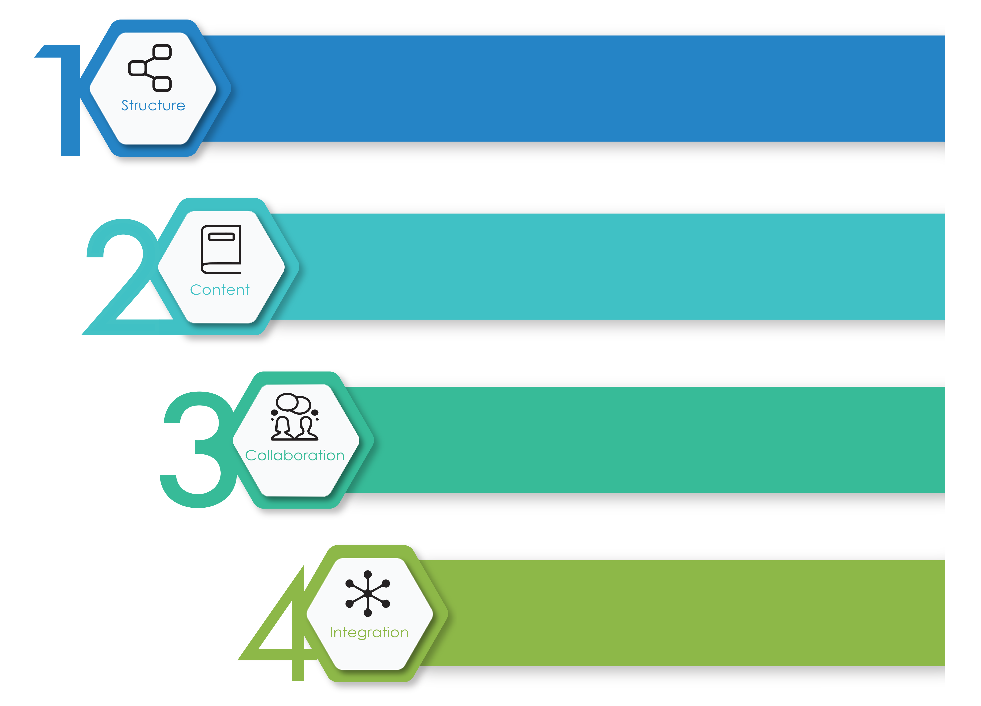
It's as Easy as 1.2.3…4
A powerful job description repository must include:
  Structure
  Content
  Collaboration
  Integration
Create consistency across your job description repository by maintaining a uniform format and a structured process.
Provide editors with a wide variety of resources to pull content.
Allow Managers or anyone with relevant knowledge to suggest revisions to a job descriptions while giving HR/Compensation the ability to accept, reject or modify those suggestions incrementally.
Empower your enterprise by disseminating accurate and approved job information to other systems.
Notes:
How does JDXpert help us gain control of our JDs?
Structure and Efficiencies to the way you construct, manage and store job information
Content in addition to AI generated JDs JDX has over almost 30,000 curated JDs (Sample and crowd sourced) and 250,000 AI processed job postings from the web,
Collaboration - online using flexible workflows that you can set up with multiple steps/participants, even add participants on the fly.
4.Integration JDXpert not only helps you get your job data in shape, but we can also feed this now accurate, vetted, approved job data to your other systems

Slide 48
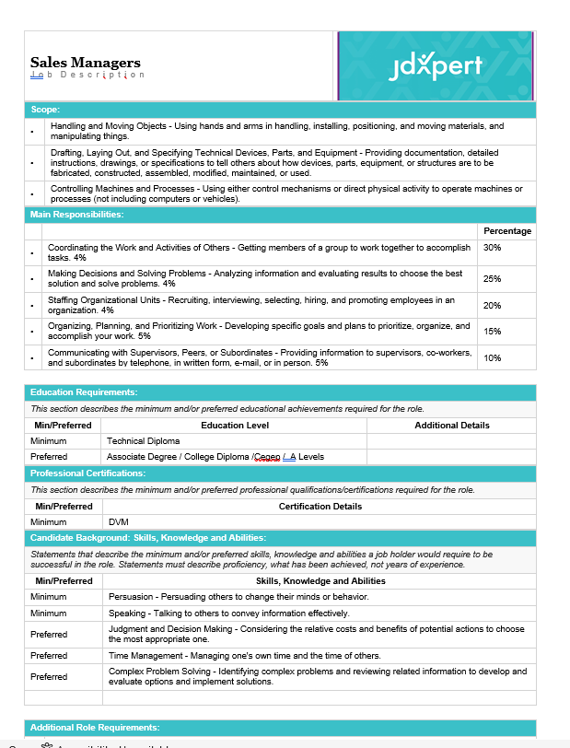
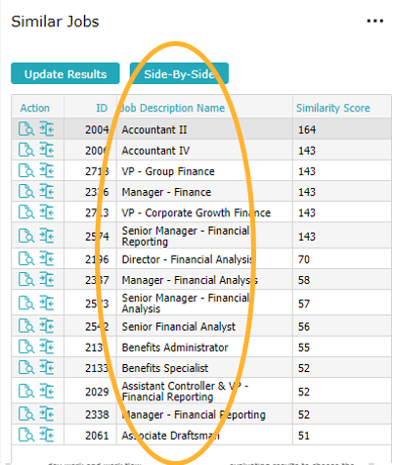
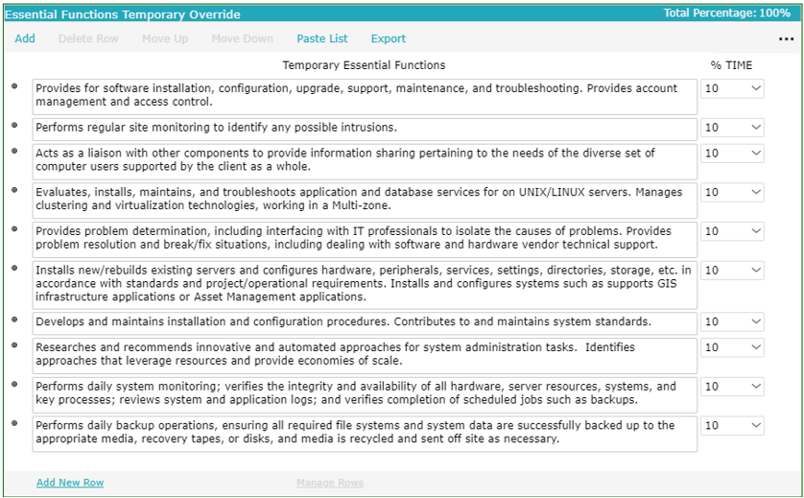
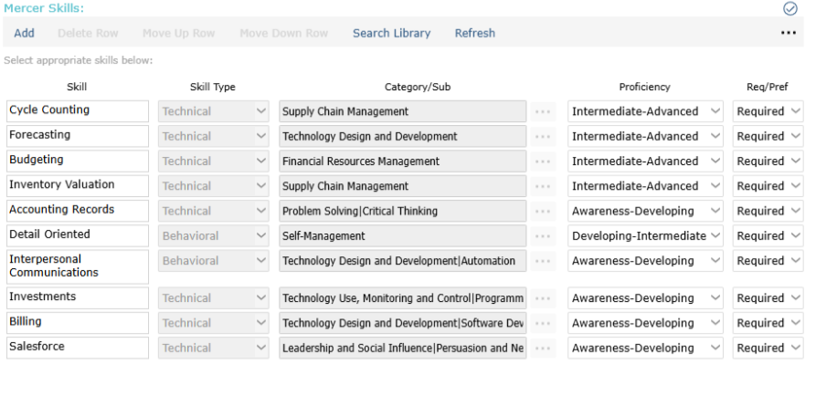
Build on a Solid Foundation
Understanding the tasks involved for a job in real-time are critical to adapt to changing AI capabilities
Skills are essential for effective recruiting and talent management especially as work changes
Leveraging the hidden workforce requires matching capabilities with the requirements of the job
Transparency rests on equity and equity relies on understanding work
Notes:
AI – Understanding Specific Tasks, Qualifications, Skills and Competencies
Will allow you to understand which aspects of a job can be automated/augmented by AI,
And which tasks still require the human touch
Allowing you to proactively manage employee pivot to other tasks to maintain coherent control as you integrate AI
Skills- no matter what your opinion is of Skills-based recruiting.

Slide 49
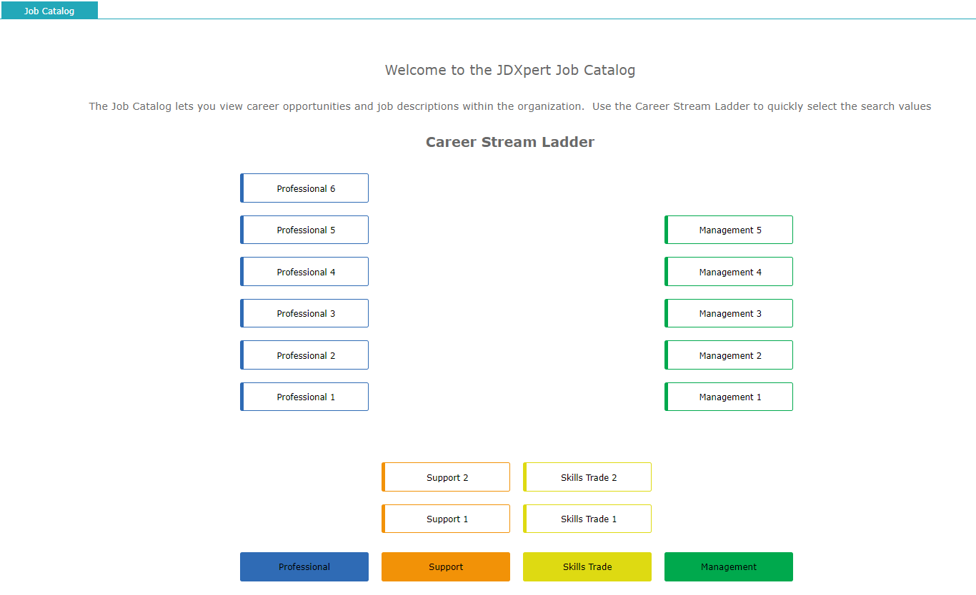
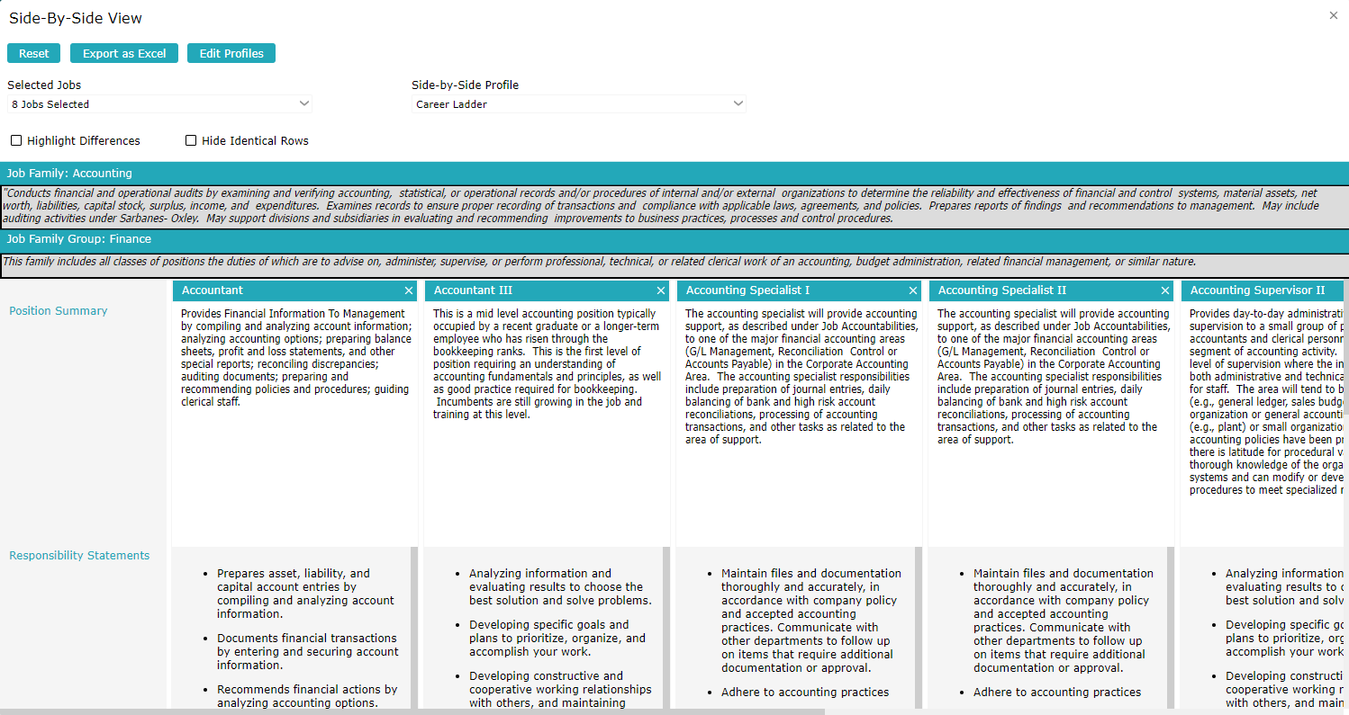
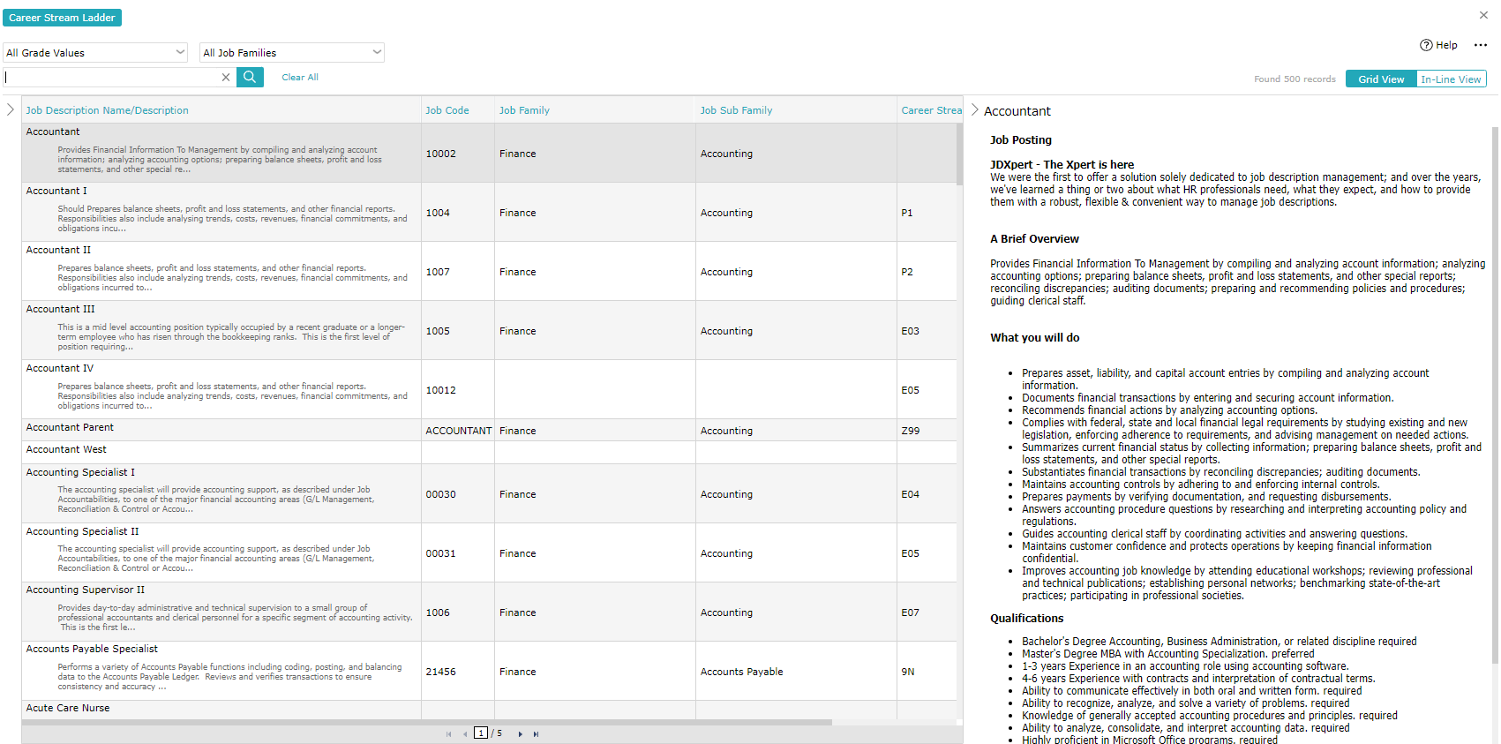
Managing Work Holistically
Productivity + Consistency
Top-down approaches like job architecture and parent/child hierarchies
Productivity tools like side-by-side views, similarity scoring merge and mass change
Maintain jobs in context of progressions instead of one at a time

Slide 50
Final Poll
How are you currently managing job information?
I’m not
Word docs via email
I have a standalone system
I have a system integrated with my talent management applications
Notes:
Ok, so without reading the Study/Article give us your gut feel on this one.

Slide 51

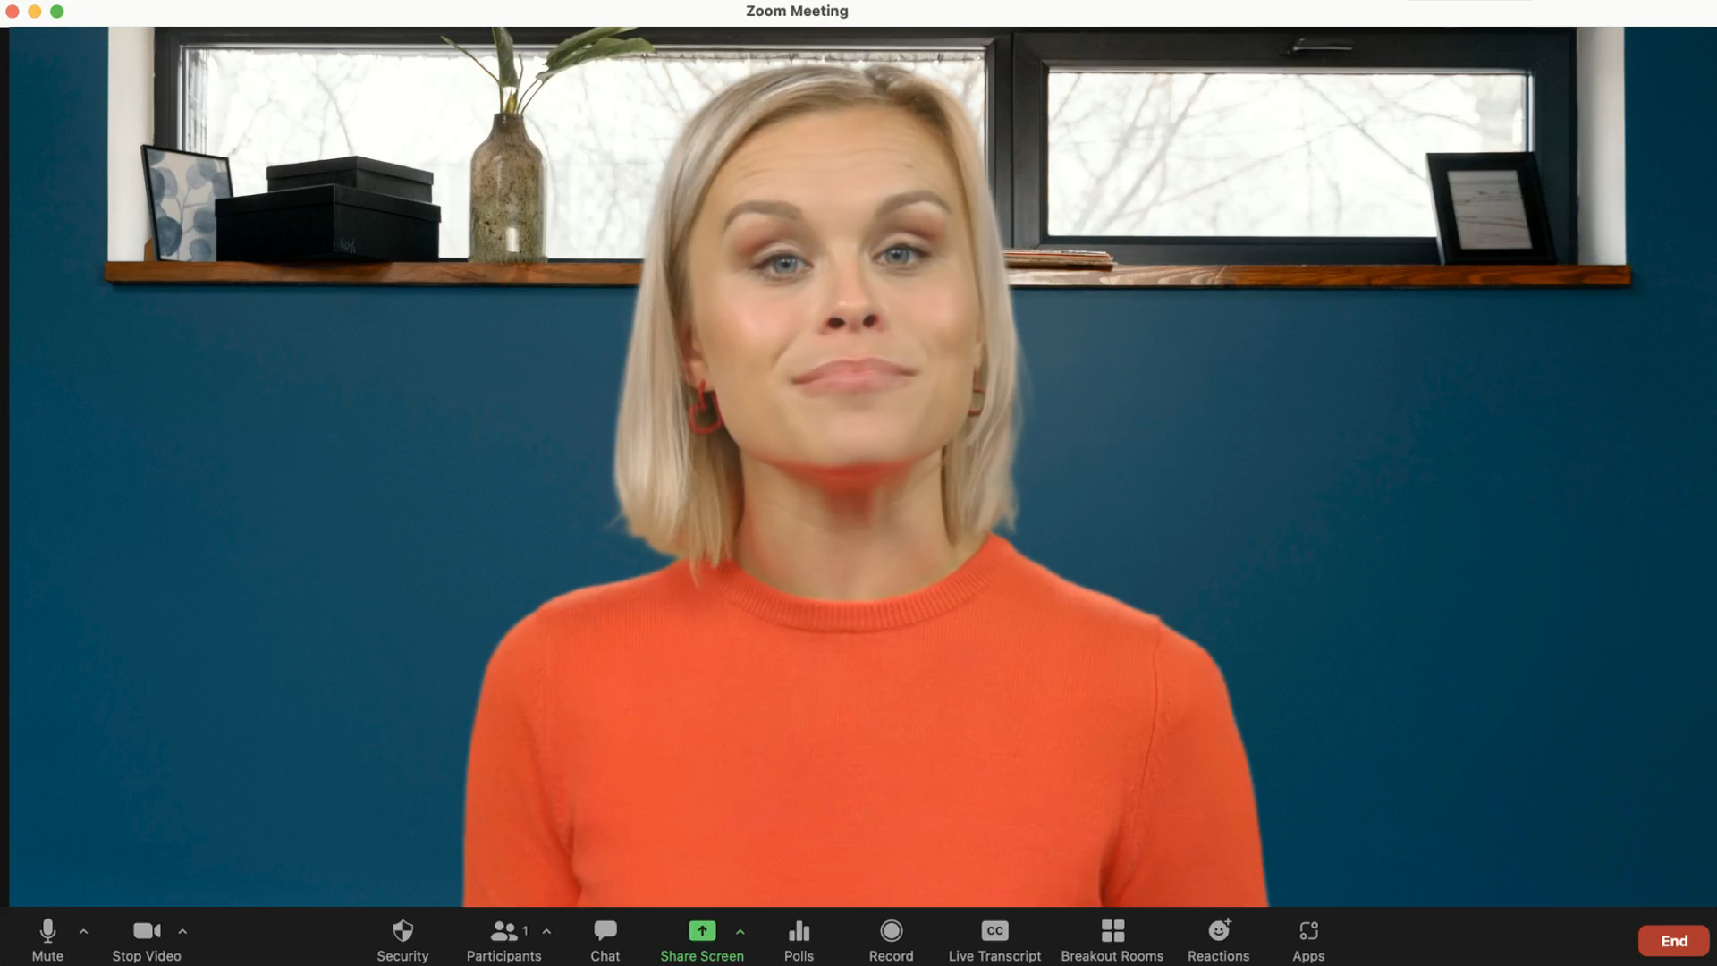

Slide 52

Questions?

Slide 53
Thank You!
For more information about JDXpert and how we’re embracing AI, visit jdxpert.com
As a thank you for joining us today, click here to download a free copy of our eBook, How To Beat The Talent Shortage One Job Description At A Time

